Slide 1
WELCOME

Slide 2
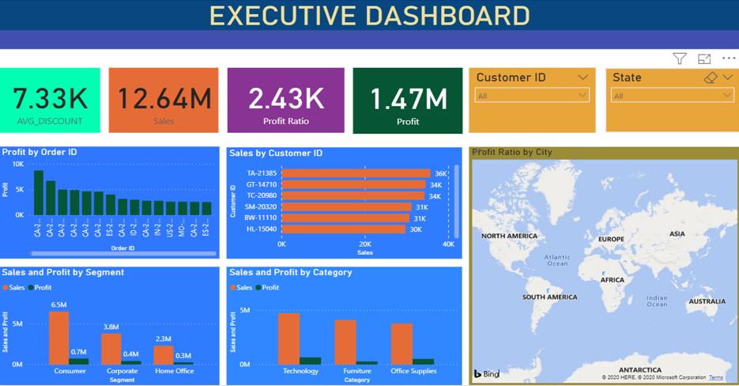
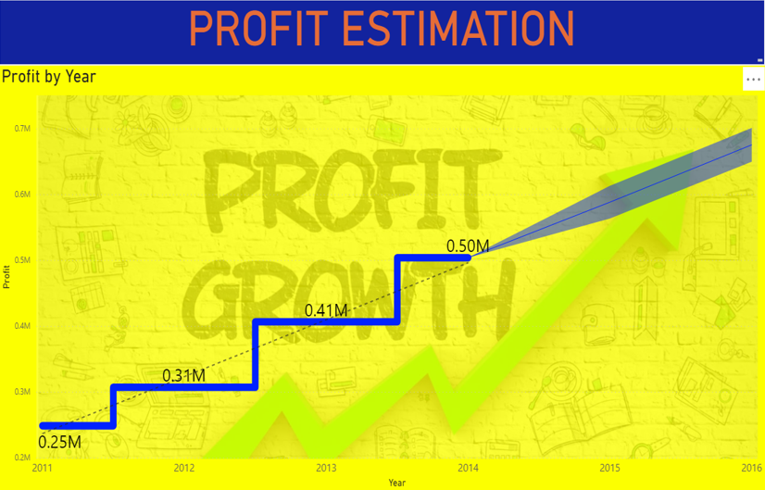
Power-BI Dashboards
Project in Power-BI on the Global Superstore Dataset,
Dashboards on various Entities.

Slide 3
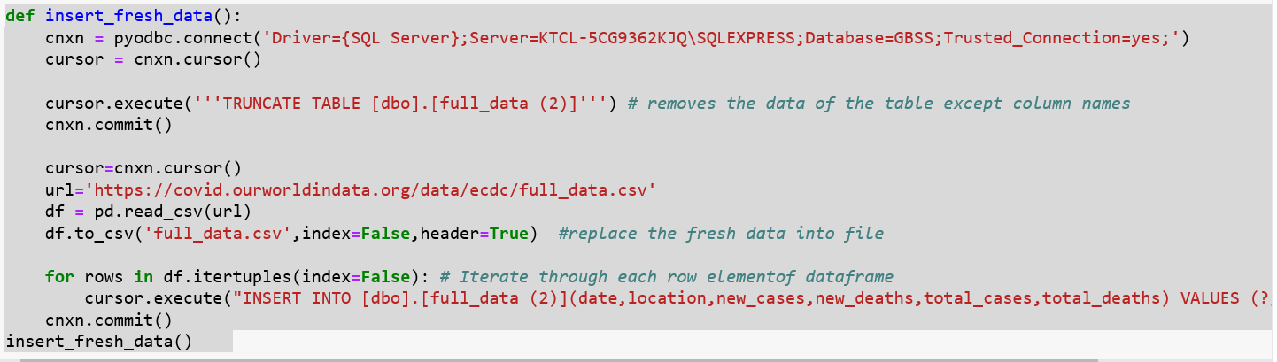
Python function for COVID-19 project

Slide 4
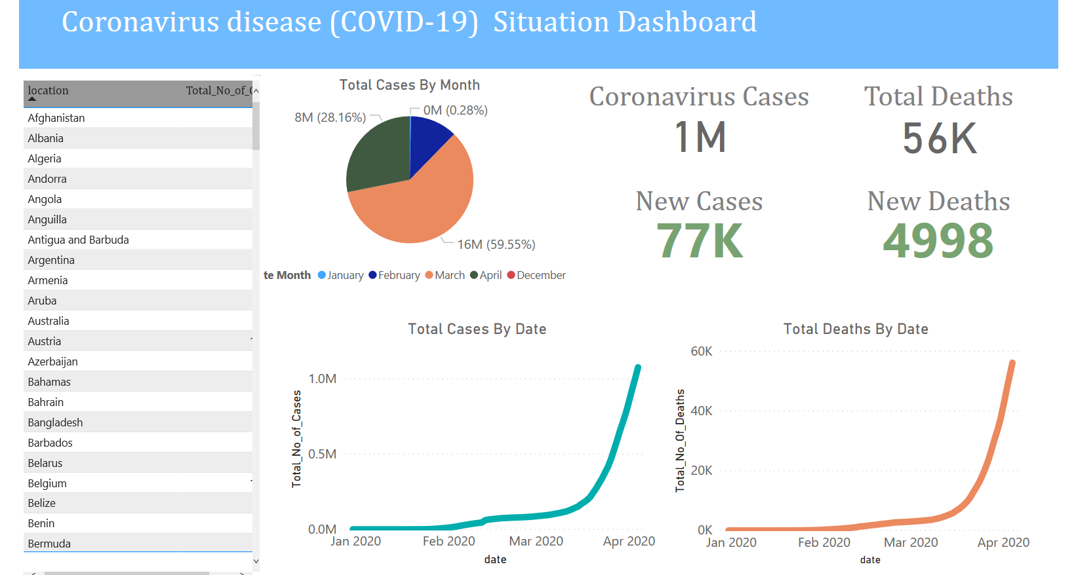
Dashboard created from the live data gathered from the function executed and published in Power-BI

Slide 5
Thank You

